Slide 1
2024 Boca-ECGI
Discussion of:
Spreading Sunshine in Private Equity:
Financial Intermediation and Regulatory Oversight
By Yingxiang Li
Discussant: Donghyun Kang (Erasmus School of Economics)

Slide 2
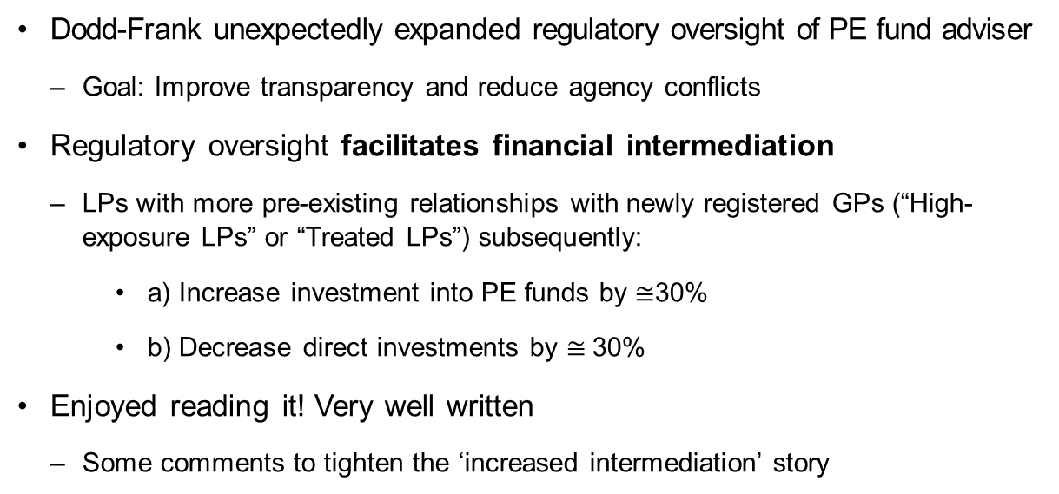
Summary of Key Findings
Dodd-Frank unexpectedly expanded regulatory oversight of PE fund adviser
Goal: Improve transparency and reduce agency conflicts
Regulatory oversight facilitates financial intermediation
LPs with more pre-existing relationships with newly registered GPs (“High-exposure LPs” or “Treated LPs”) subsequently:
a) Increase investment into PE funds by $≅$30%
b) Decrease direct investments by $≅$30%
Enjoyed reading it! Very well written
Some comments to tighten the ‘increased intermediation’ story

Slide 3
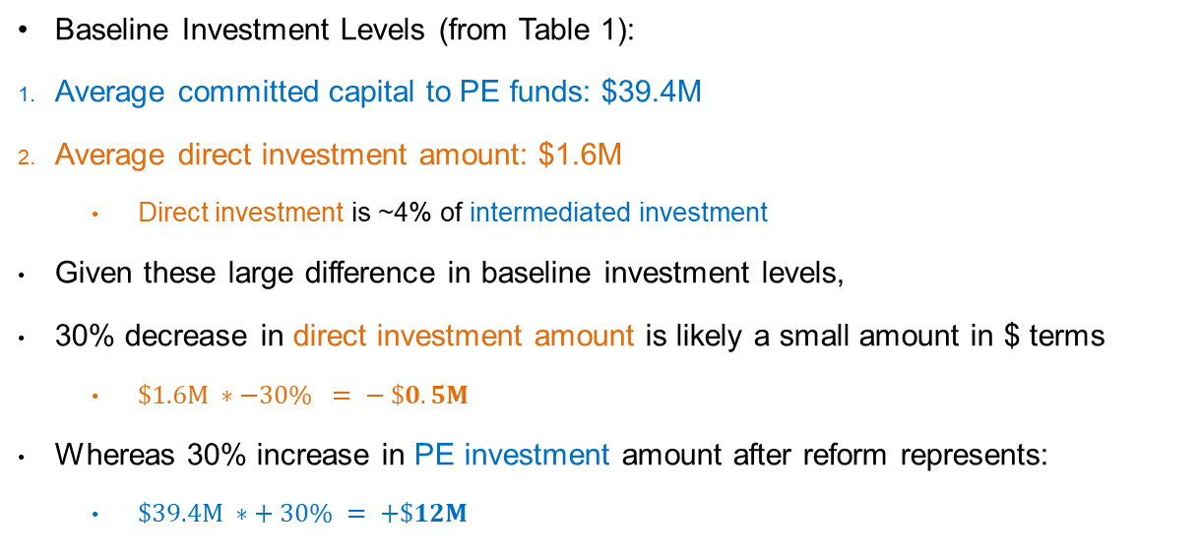
Economic Magnitudes: Direct vs. Intermediated Investment
Baseline Investment Levels (from Table 1):
Average committed capital to PE funds: $39.4M
Average direct investment amount: $1.6M
Direct investment is ~4% of intermediated investment
Given these large difference in baseline investment levels,
30% decrease in direct investment amount is likely a small amount in $ terms
$\$1.6M ∗−30\% = − \$0.5M$
Whereas 30% increase in PE investment amount after reform represents:
$\$39.4M ∗+ 30\% = +\$12M$

Slide 4
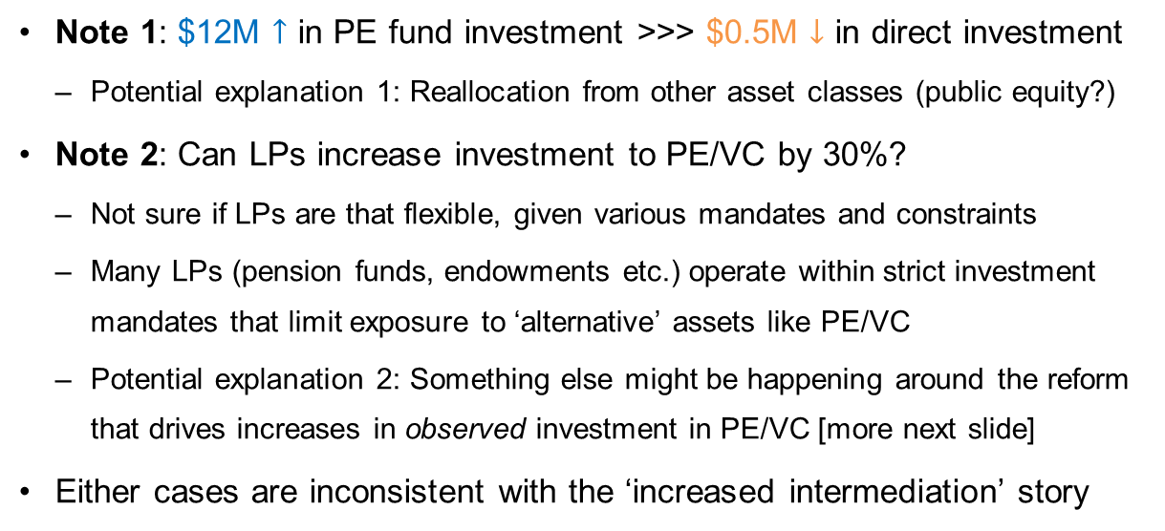
Institutional Constraints: Can LPs Be This Flexible?
Note 1: $12M $↑$ in PE fund investment >>> $0.5M $↓$ in direct investment
Potential explanation 1: Reallocation from other asset classes (public equity?)
Note 2: Can LPs increase investment to PE/VC by 30%?
Not sure if LPs are that flexible, given various mandates and constraints
Many LPs (pension funds, endowments etc.) operate within strict investment mandates that limit exposure to ‘alternative’ assets like PE/VC
Potential explanation 2: Something else might be happening around the reform that drives increases in observed investment in PE/VC [more next slide]
Either cases are inconsistent with the ‘increased intermediation’ story
Notes:
if we consider public equities as another form of intermediated investment, then the paper's main finding of a 30% increase in PE fund investments may be better framed as a shift in the organizational structure of LPs' overall investment portfolios, rather than a net increase in financial intermediation per se.
Challenges the pure substitution from direct to intermediated investment: suggests that increased in PE investment has to come from either: by reducing investment in other asset classes or by increased funding around the Dodd-Frank. Moreover, this behavior occurs at the treated LPs only, which seems implausible.
One another possibility is: control LPs reduce PE investment, while treated LPs simultaneously increase – both treated and control groups move in opposite direction, leading to large increase in the treatment effect. However, this case also refutes the increased intermediation story – if control LPs decrease intermediation after the reform, it’s not a intermediation story anymore.

Slide 5
Data Coverage: Potential Sample Selection Issue
Paper's main result: “Treated” LPs increase investment in registered GPs
Data providers do not observe the complete set of PE/VC investments
Preqin relies on multiple sources to obtain info on investments:
Public filings and FOIA requests + Voluntary disclosures from LPs and GPs
Potential Reporting Bias:
By construction, "treated" LPs have more unregistered GPs pre-reform
My guess: After reform, registered GPs likely to disclose more
➔ Increased investments by “treated” LPs partially reflect increased reporting, not true investment changes
Suggestion:
Compare the number of reported investments before and after registration
Examine whether reporting patterns differ between registered and unregistered advisers

Slide 6
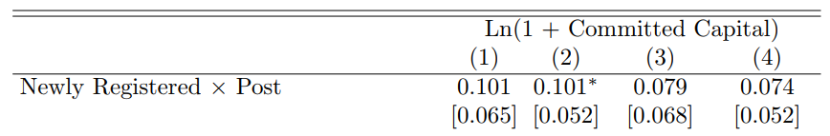
Table 7: Direct Test of the Intermediation Channel
Table 7 should provide strongest evidence for intermediation channel
The only analysis at LP-GP-Fund level (vs LP level in other tables)
Directly tracks flow of capital from LPs into newly registered vs unregistered GPs
Current result:
Magnitude is economically significant
But statistically, marginally (in)significant

Slide 7
Strengthening the Analysis: Alternative Specifications
Suggestion 1
To address the power issue, use LP-GP level data
While less granular than LP-GP-Fund level, still more so than LP level analysis
Can still test whether treated LPs are more likely to invest in any fund of registered GPs
Suggestion 2: Regression Discontinuity Design
Exploit $150M AUM threshold for registration requirement
Compare GPs just above/below $150M threshold before the reform
Approximates random assignment to registration
Notes:
Suggestion 1: is it common in the literature?

Slide 8
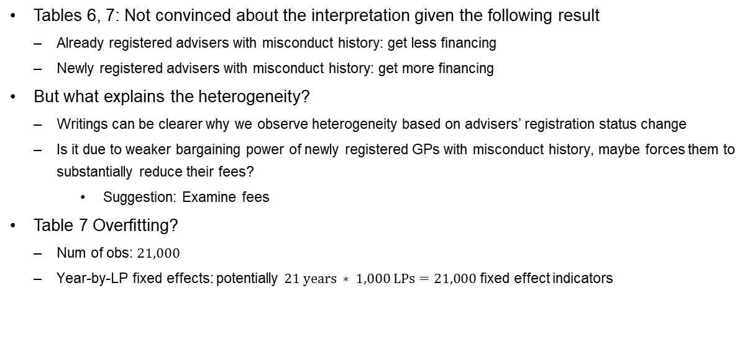
Interpreting the Misconduct result
Tables 6, 7: Not convinced about the interpretation given the following result
Already registered advisers with misconduct history: get less financing
Newly registered advisers with misconduct history: get more financing
But what explains the heterogeneity?
Writings can be clearer why we observe heterogeneity based on advisers’ registration status change
Is it due to weaker bargaining power of newly registered GPs with misconduct history, maybe forces them to substantially reduce their fees?
Suggestion: Examine fees
Table 7 Overfitting?
Num of obs: $21,000$
Year-by-LP fixed effects: potentially $21 years ∗ 1,000 LPs=21,000$ fixed effect indicators

Slide 9
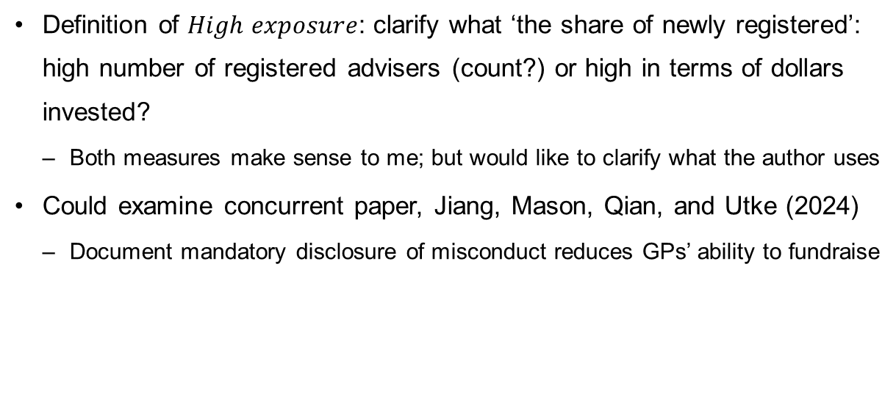
Other comments
Definition of $High exposure$: clarify what ‘the share of newly registered’: high number of registered advisers (count?) or high in terms of dollars invested?
Both measures make sense to me; but would like to clarify what the author uses
Could examine concurrent paper, Jiang, Mason, Qian, and Utke (2024)
Document mandatory disclosure of misconduct reduces GPs’ ability to fundraise

Slide 10
Conclusion
Great paper that highlights how regulatory oversight affects financial intermediation
Examines a landmark reform (Dodd-Frank Act) and its effect on PE industry
Oversight can complement market discipline, increasing investments via intermediaries
Provided few thoughts on how to tighten the ‘increased intermediation’ story
Does modest reduction in direct investment $ plausibly support the story?
Can you examine systematic changes in LP/GP reporting around the reform?
Update specification/identification to sharpen the story
Thank you!

